Slide 1
Section 2.7 Factoring GCF and Trinomials
© Copyright all rights reserved to Homework depot: www.BCMath.ca

Slide 2
I) What is Factoring?
When Expanding with Brackets, Multiply each term inside the brackets with the monomial in front
Expand:
FACTOR:
Factoring is the opposite of Expanding. First find the GCF, then Divide each term in the brackets by the GCF. Write the expression as a product with the GCF in front and the remaining polynomial on the right
When you factor, write is a product of the terms. DO not EXPaND them!!

Slide 3
Practice: Find the GCF and then Factor Each of the Following:
No Common Factors!
NOTE:

Slide 4
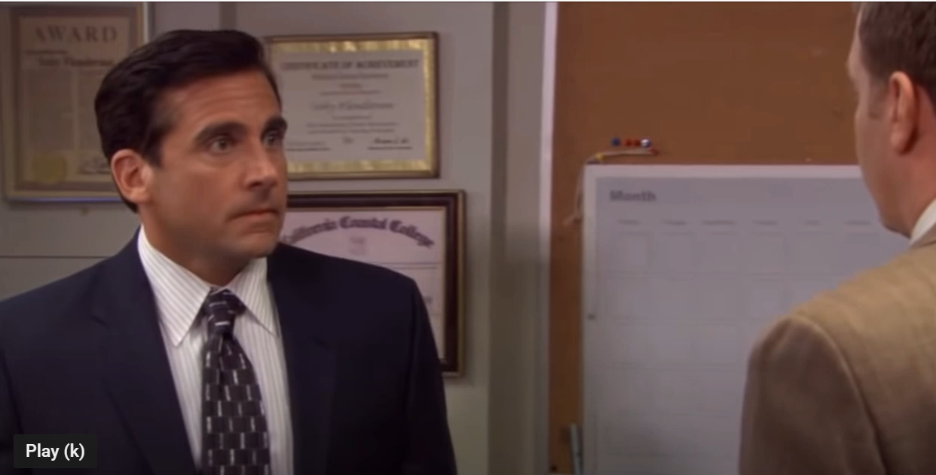
Simplifying Expressions by Factoring GCF
Factoring is very useful for simplifying expressions when you don’t have a calculator
Since all the terms are multiples of “4”, factor out the “4” at the top!
You can cancel out the 4’s at the top and bottom since they are factored out
On a side note, if a term is added or subtracted in the top, you can NOT cancel it with the denominator!!!!
NO!!!!!
NO!!!!!
YES

Slide 5
Practice: Simplify each expression below by factoring

Slide 6
II) Learning to Factor Trinomials
The Goal of this next part of the lesson is to learn how to convert a trinomial back into the product of two binomials
What pattern do you notice about the middle numbers?
It is equal to the SUM of the 2 numbers in the bracket
What pattern do you notice about the last numbers?
It is equal to the PRODUCT of the 2 numbers in the bracket

Slide 7
III) Factoring Trinomials:
When Factoring Trinomials the goal is to split the expression into product of two binomials
  Start with all pair of numbers that multiply to constant “C”
  Choose the pair that adds to the middle coefficient “b”
  Take the pair of numbers and place it in the brackets
Ex: Factor the following trinomials
Find all pairs that multiply to “C”
Adds to 12
Adds to -12
Adds to 36
Adds to -36
Pick ONLY the pair that ADDS to “B”

Slide 8
Practice: Factor
Find all pairs that
multiply to “C”
Adds to -8
Adds to 6
Adds to 8
Adds to -6
Adds to 32
Adds to 10
Adds to -32
Adds to -10
Pick ONLY the pair
that ADDS to “B”
Pick ONLY the pair
that ADDS to “B”

Slide 9
IV) Factoring Trinomials with CGF or Powers of ‘4’
When there is a common factor in all three terms, take out the GCF first, and then factor the trinomial
G.C.F.
Factor the Trinomial
When there is a Power of “4”, the x’s in the binomial will be powers of “2”

Slide 10
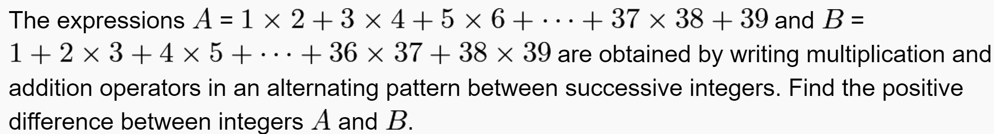
Aime I 2015: Try to do this question by factoring
Practice: Factor the following
Practice: Evaluate by factoring
Challenge:

Slide 11
Practice: Factor

Slide 12
Aime I 2015: Try to do this question by factoring

